Slide 1

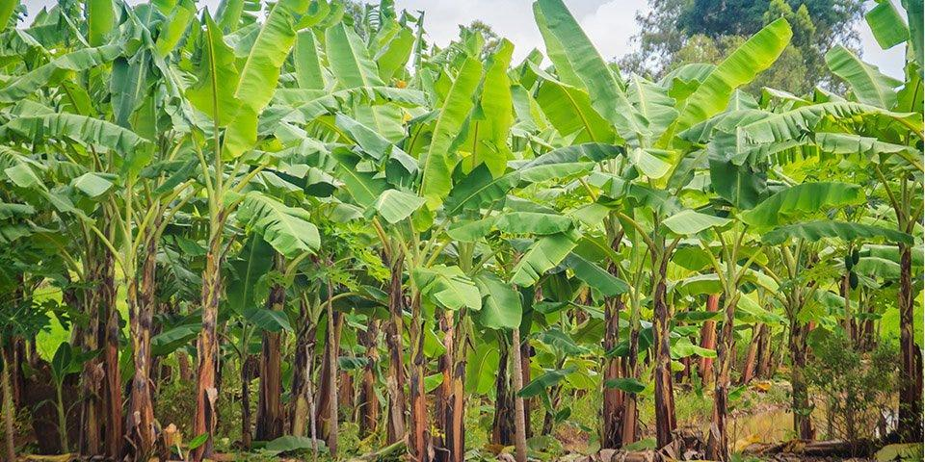
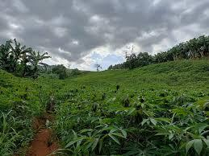
Customer Discovery - Week 2
Fruit & Crop Farmers

Slide 2
Hacker, Hipster, and Hustler describes a framework for understanding the essential roles within an entrepreneurial startup team. The goal of this “three-H” model is to ensure a balanced team with the necessary skills to bring an idea from concept to a successful, sustainable business.

Slide 3
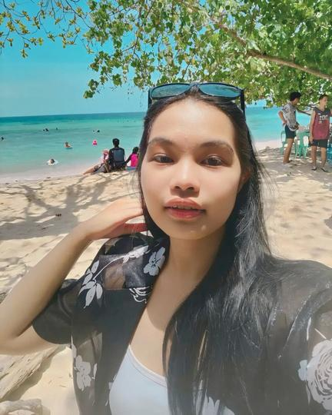
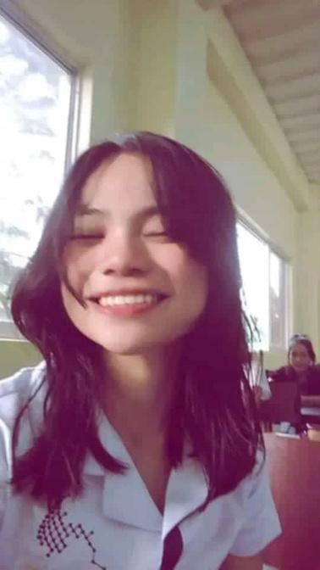
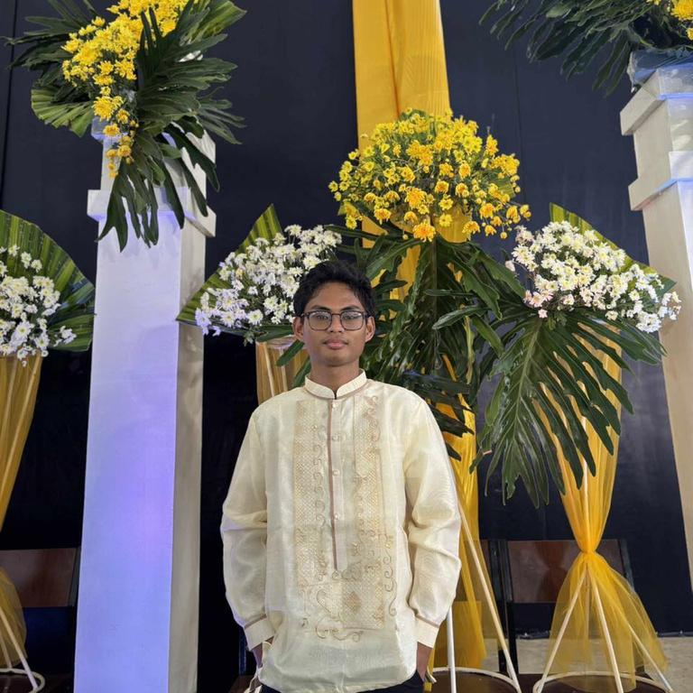
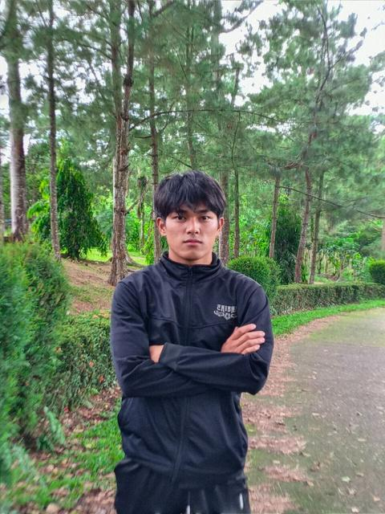
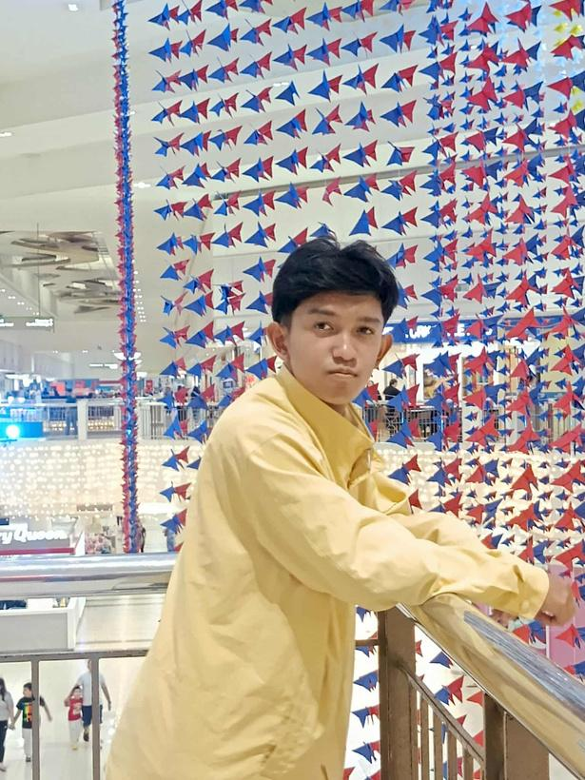

Group
7
Princess Grace Marie Z.
Sitoy
Emeliza A. Borres
HIPSTERS
Milwaukee D. Arrubio
HUSTLER
Rex Dominic B. Sihay
Sebastian Anthony G. Acierto
HACKERS

Slide 4
Deadline Date for the Interview: September 22, 2025
Number of Interviewees: Ten (10)
Customer Segment: Crop Farmers and Fruit Farmers

Slide 5
01
Pests like rats, worms, rice bugs, and black bugs damage crops and reduce harvests.
02
They need to look for buyers by themselves, to sell their produce.
03
When it comes to their produce, they have little to no choice but to sell in
low prices.
04
Weather conditions, Land issues and poor soil health lower crop yield and quality.
05
Limited financial support prevents farmers from improving or recovering their operations.
Challenges/Pains Encountered by the Interviewees

Slide 6
01
Chemical Poisons to deal with rats, Chemical Solutions through spray
methods to address worms, rice bugs and black bugs.
02
They go to Markets where they can sell their produce.
03
They Connect with acquainted buyers to secure fair trade but they
said that this rarely happens due to various reasons.
04
Manual tilling of land areas through personal efforts or hiring laborers
and pairing these actions with fertilizers(organic or inorganic).
05
Personal Money for funding or Become members of Department of
Agriculture related Organizations/Cooperatives for Cash and
Farm Materials and Equipment Assistance.
Existing Solutions

Slide 7
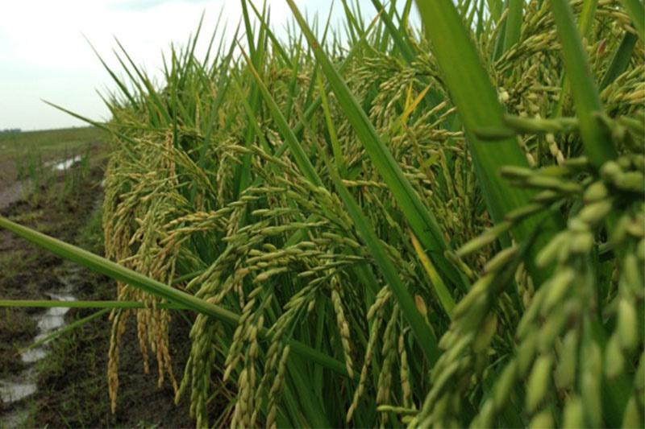
1.
Trading Disadvantages(Buyer Availability and Low Price Trades)
Top 3 Problems Need to Address
2.
Inadequate Support Mechanisms for Small-scale Farmers.
3.
Pests and Rodent Infestations

Slide 8
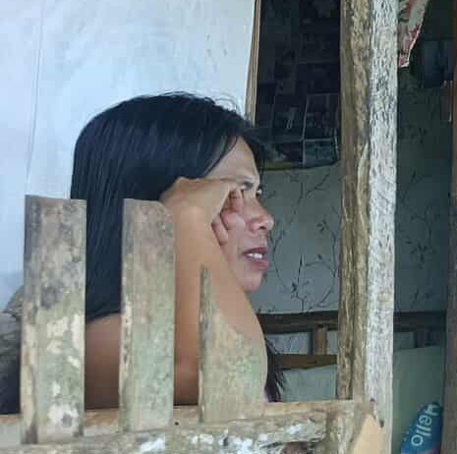
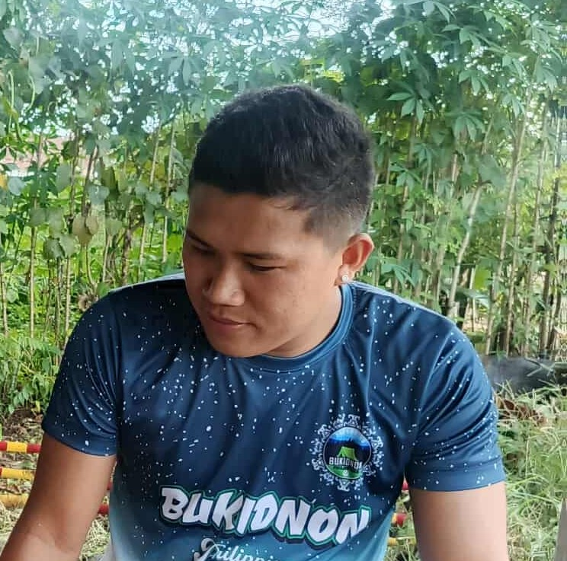
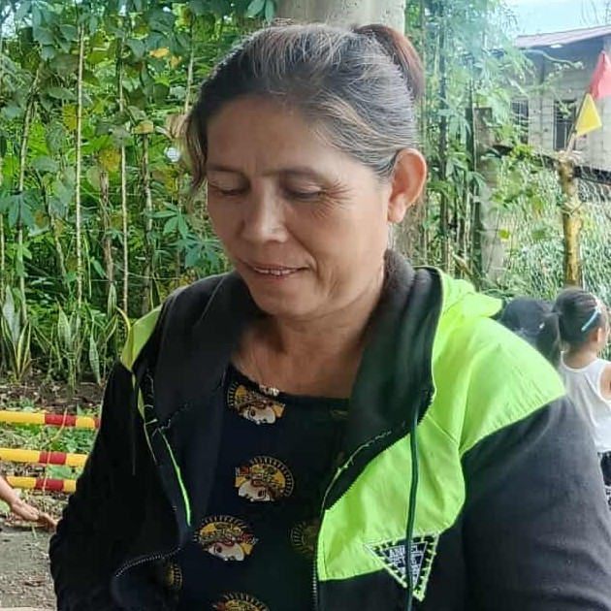
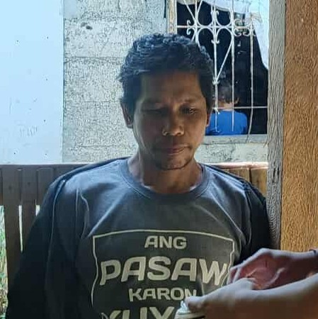
Our Interviewees
Name:
Name:
Retchelyn B. Dalayap
Name:
Ryan M. Nacario
Name:
Norma Dinampo
Jemar D. Dael
Age:
45 Years Old
Age:
26 Years Old
Age:
55 Years Old
Age:
50 Years Old
Address: Cabacungan
Address: Cabacungan
Address: Cabacungan
Address: Cabacungan
Occupation: Farmer
Occupation: Farmer
Occupation: Farmer
Occupation: Farmer
Interview Date:
September 20,2025
Interview Date:
September 20,2025
Interview Date:
September 20,2025
Interview Date:
September 20,2025
Engagement Type: (In Person)
Engagement Type: (In Person)
Engagement Type: (In Person)
Engagement Type: (In Person)

Slide 9
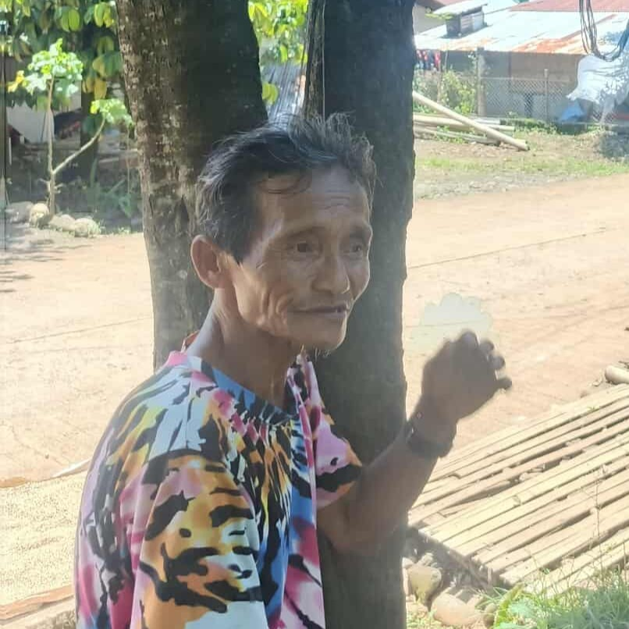
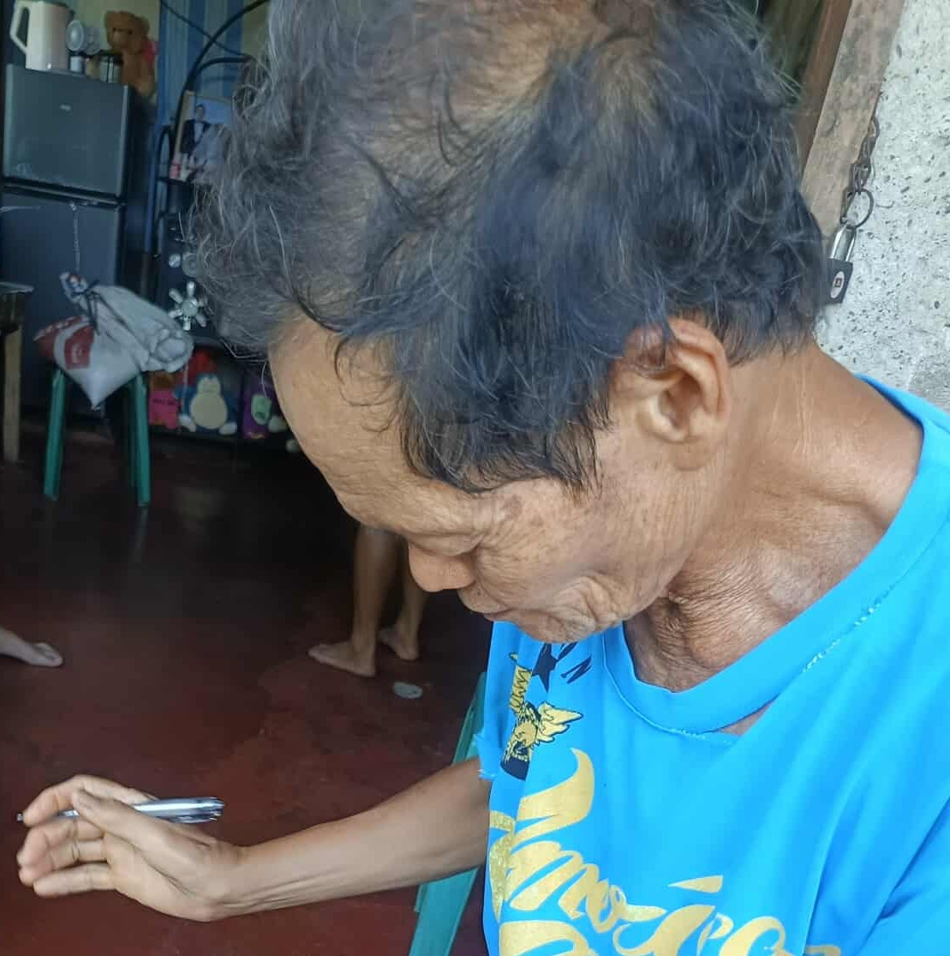
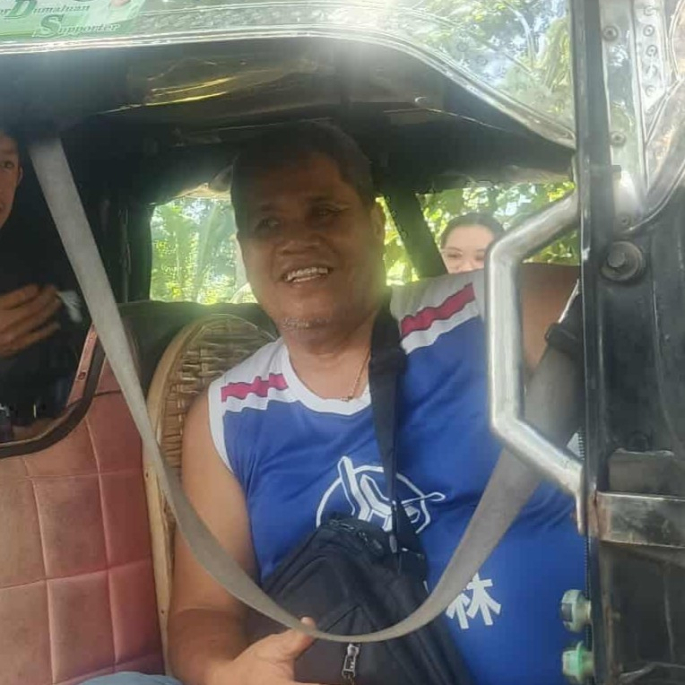
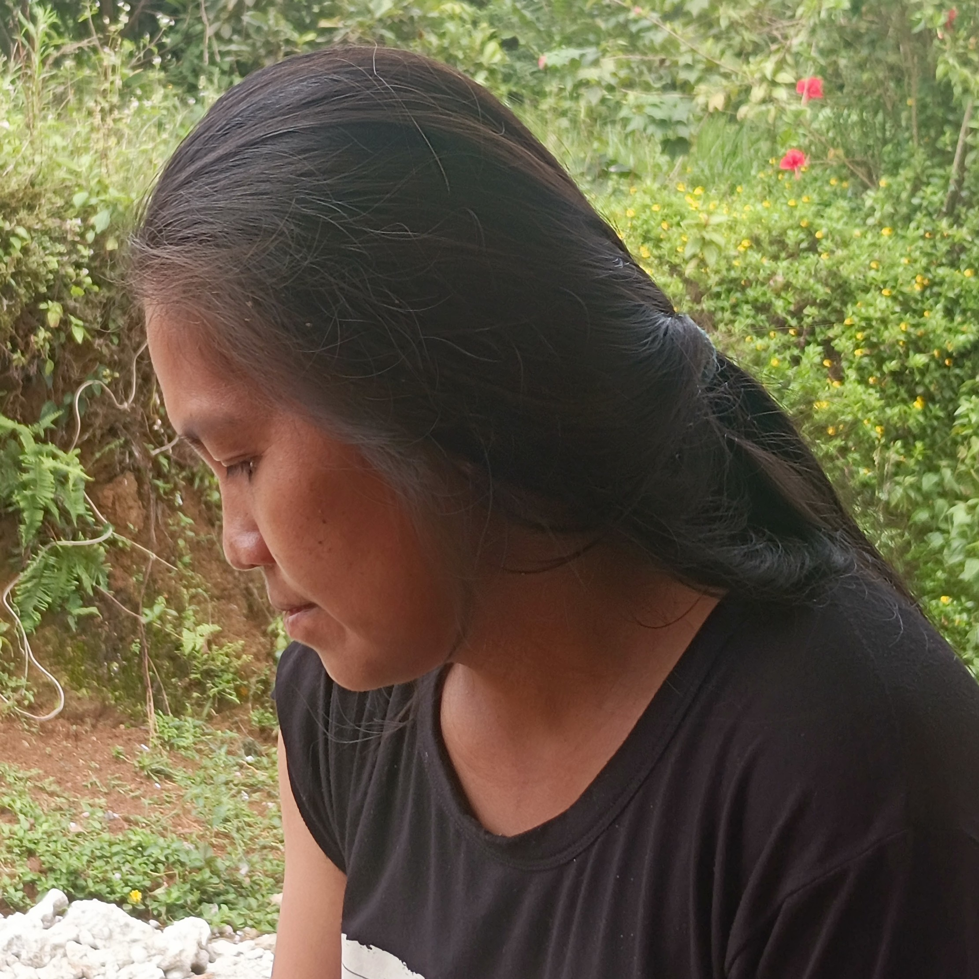
Our Interviewees
Name:
Rogelito Paguican
Name:
Domenador Onera Jr.
Name:
Arthur V. Itum
Name:
Cristy B. Orillosa
Age:
64 Years Old
Age:
64 Years Old
Age:
64 Years Old
Age:
34 Years Old
Address: Cabacungan
Address: Cabacungan
Address: Cabacungan
Address: Tuganay Sta. Cruz
Occupation: Farmer
Occupation: Farmer
Occupation: Farmer
Occupation: Farmer
Interview Date:
September 20, 2025
Interview Date:
September 20, 2025
Interview Date:
September 20, 2025
Interview Date:
September 21, 2025
Engagement Type: (In Person)
Engagement Type: (In Person)
Engagement Type: (In Person)
Engagement Type: (In Person)

Slide 10
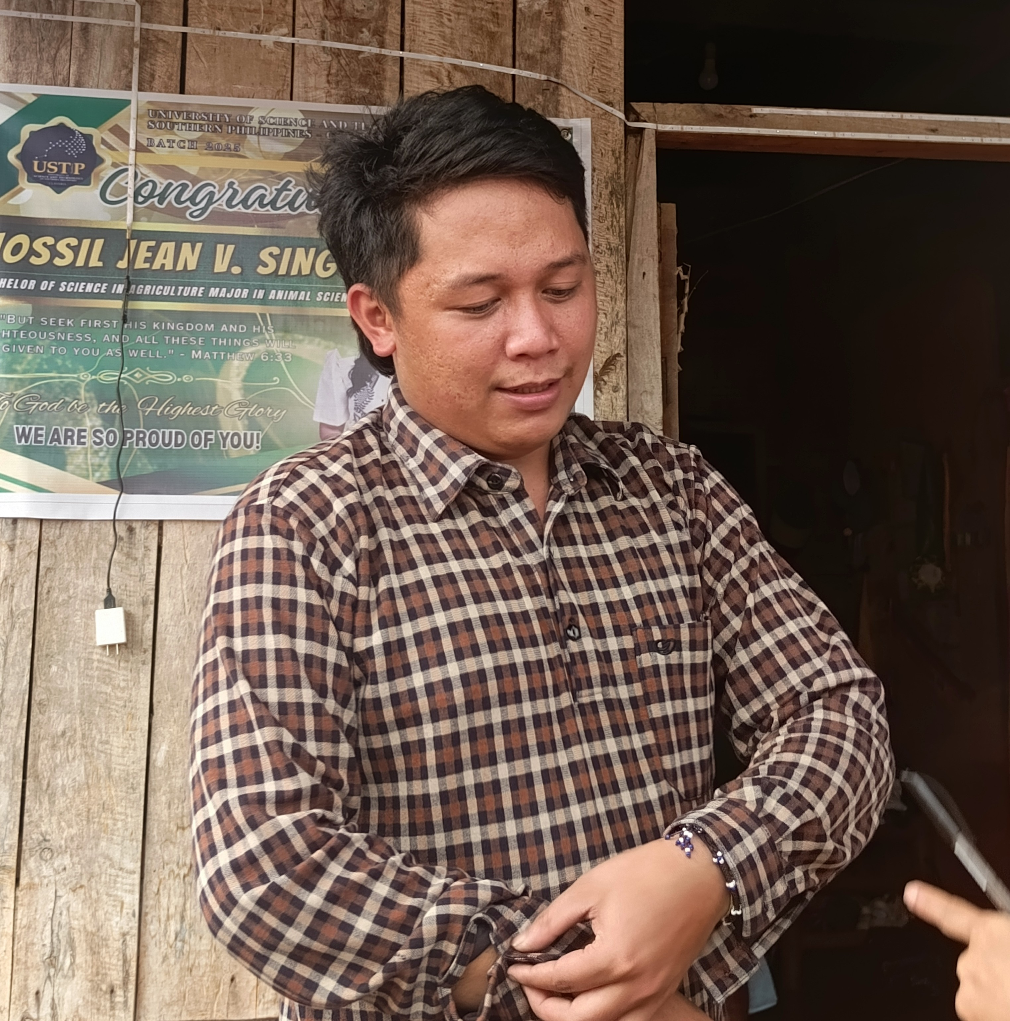
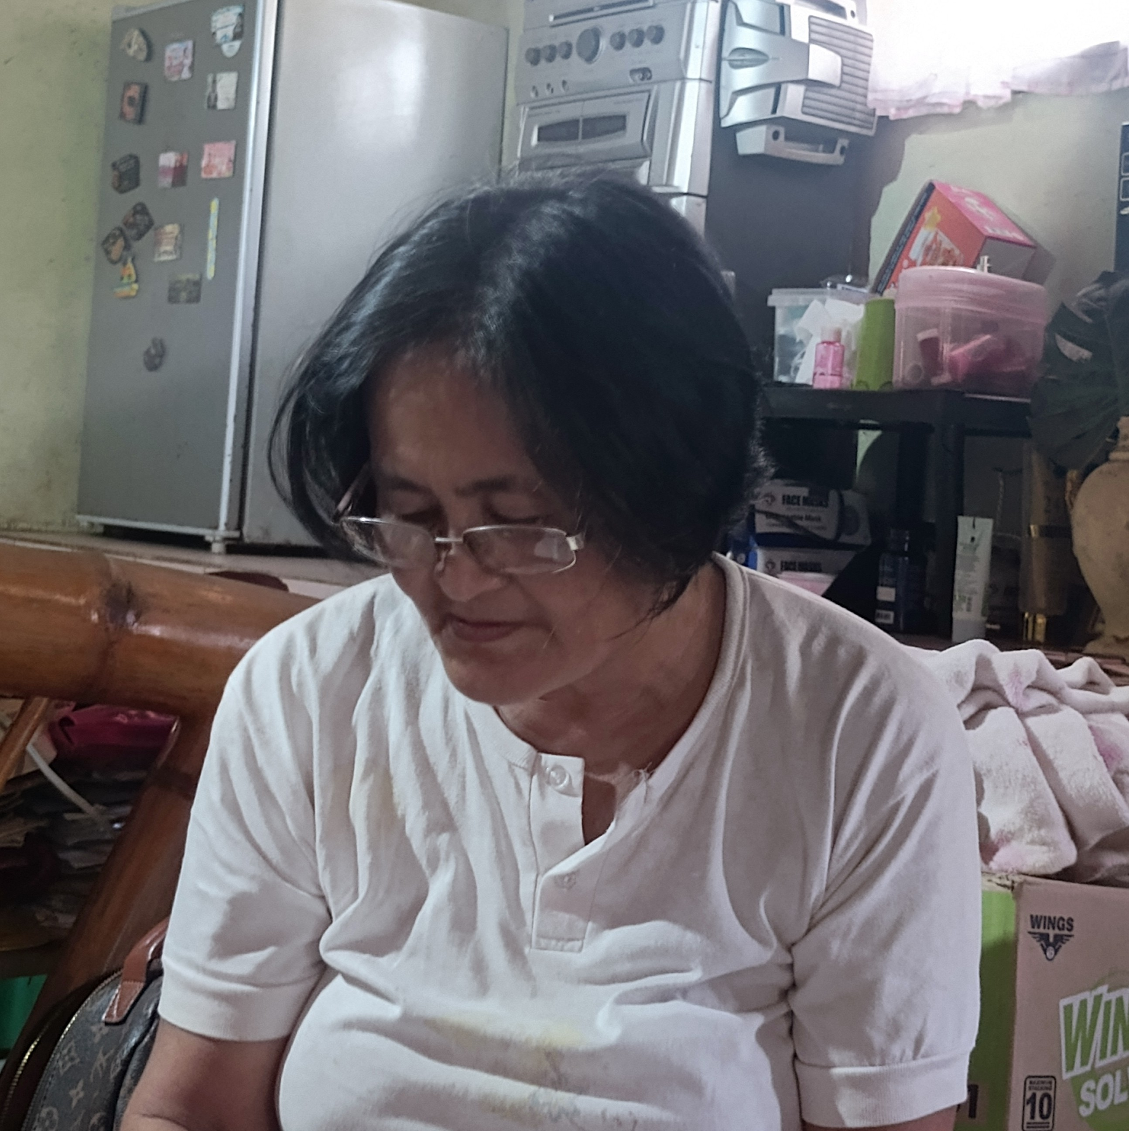
Our Interviewees
Name:
Clyde Cedric Posadas
Name:
Anita M. De Canalogan
Age:
24 Years Old
Age:
59 Years Old
Address: Tuganay, Sta. Cruz
Address: Tuganay Sta. Cruz
Occupation: Agriculturist
Occupation: Farmer
Interview Date:
September 21, 2025
Interview Date:
September 21, 2025
Engagement Type: (In Person)
Engagement Type: (In Person)

Slide 11
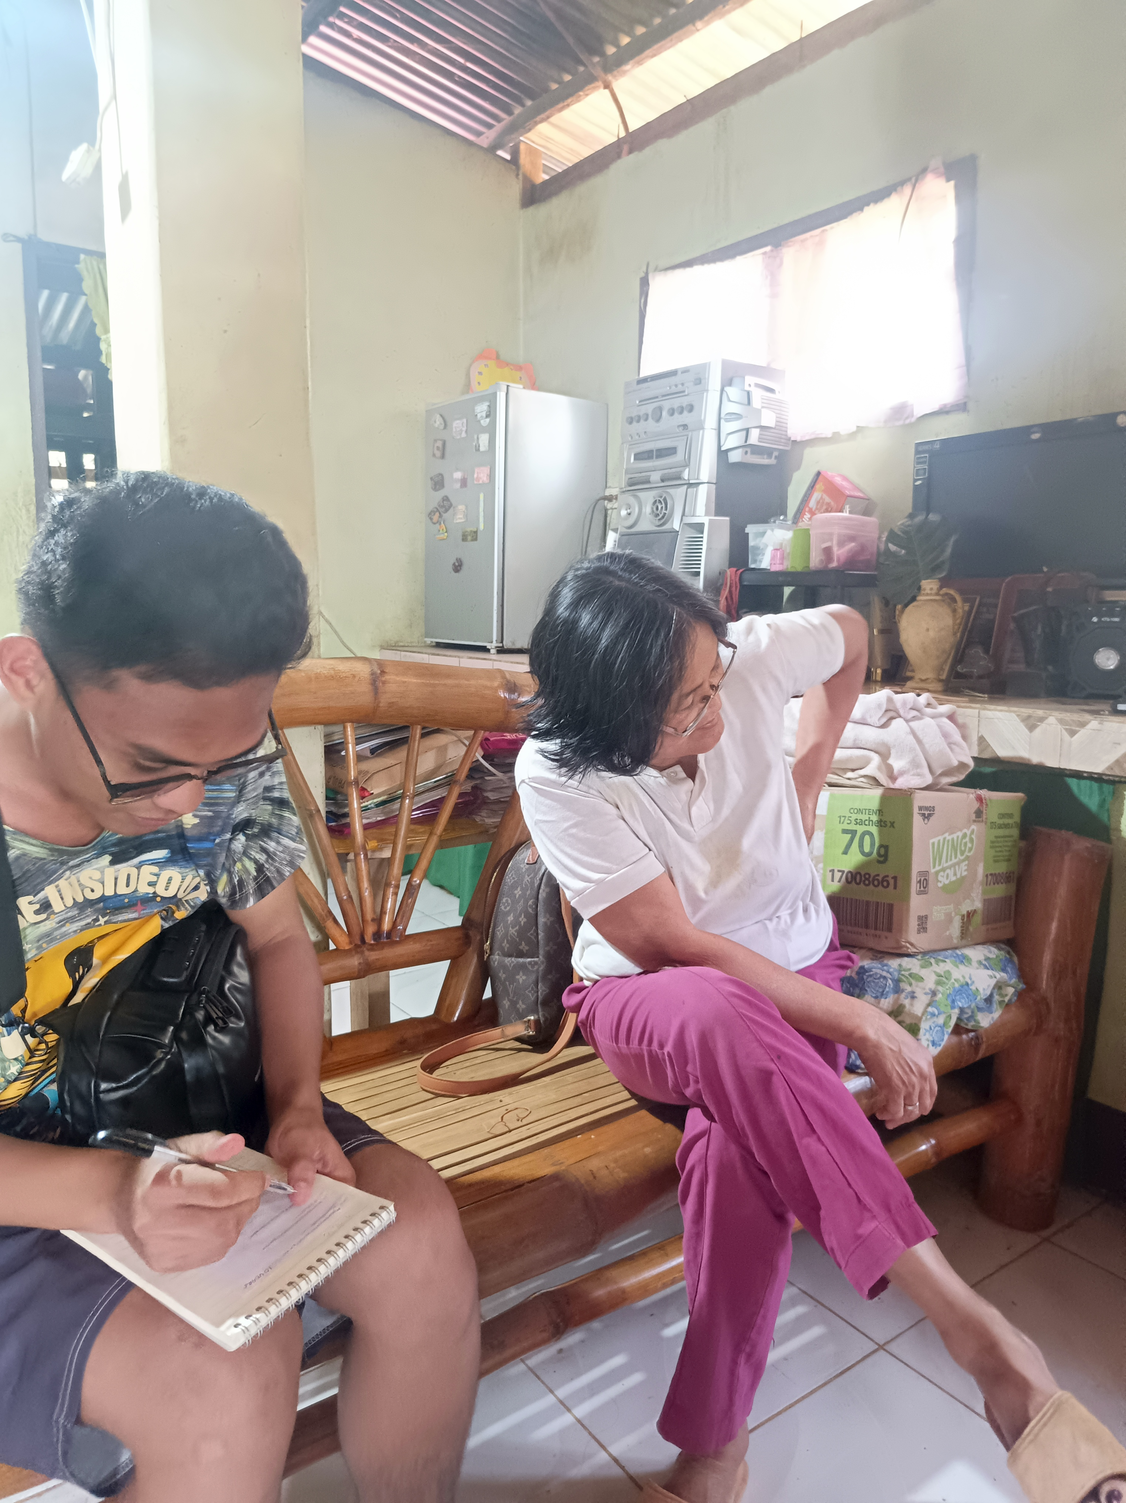
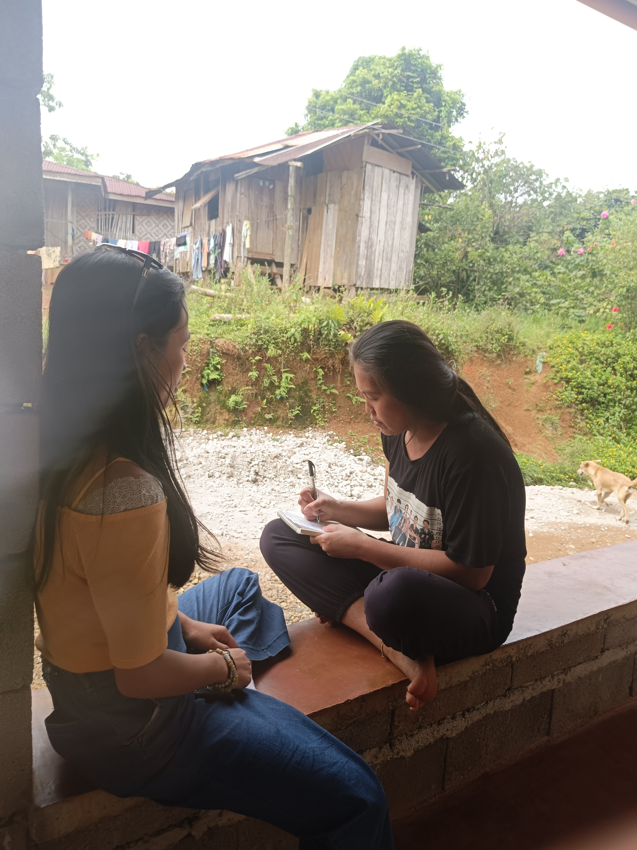
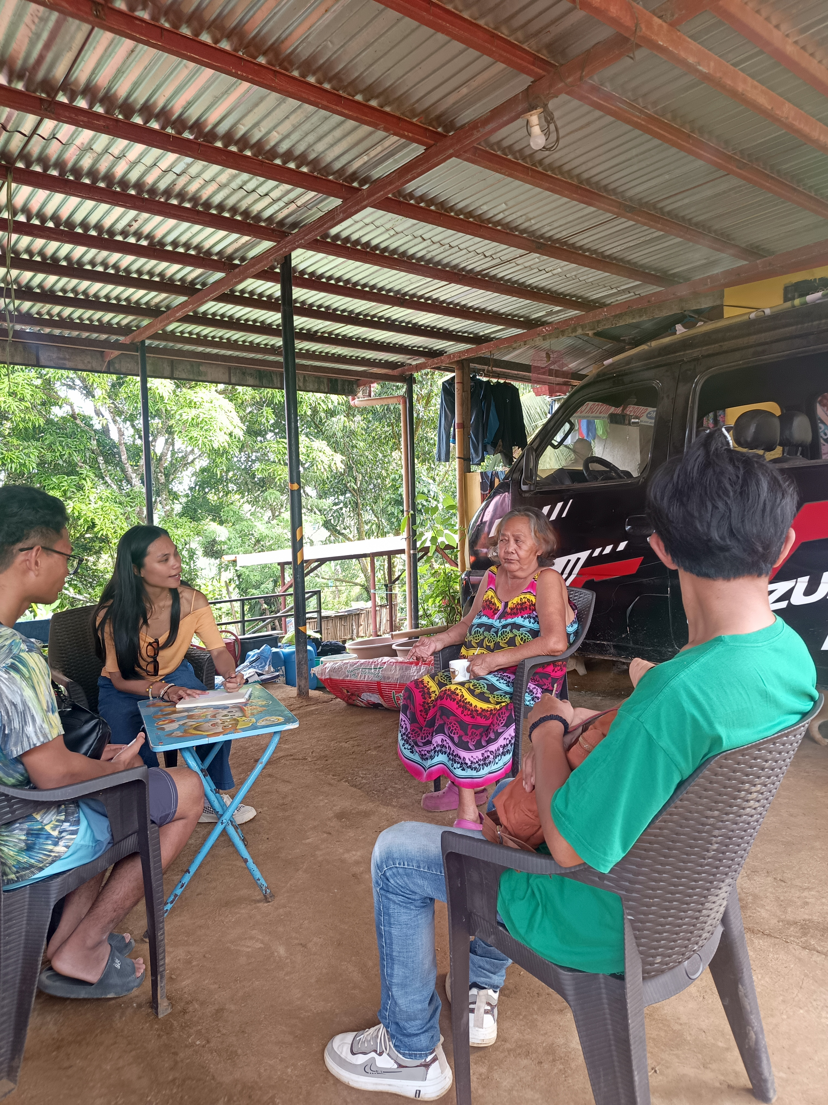
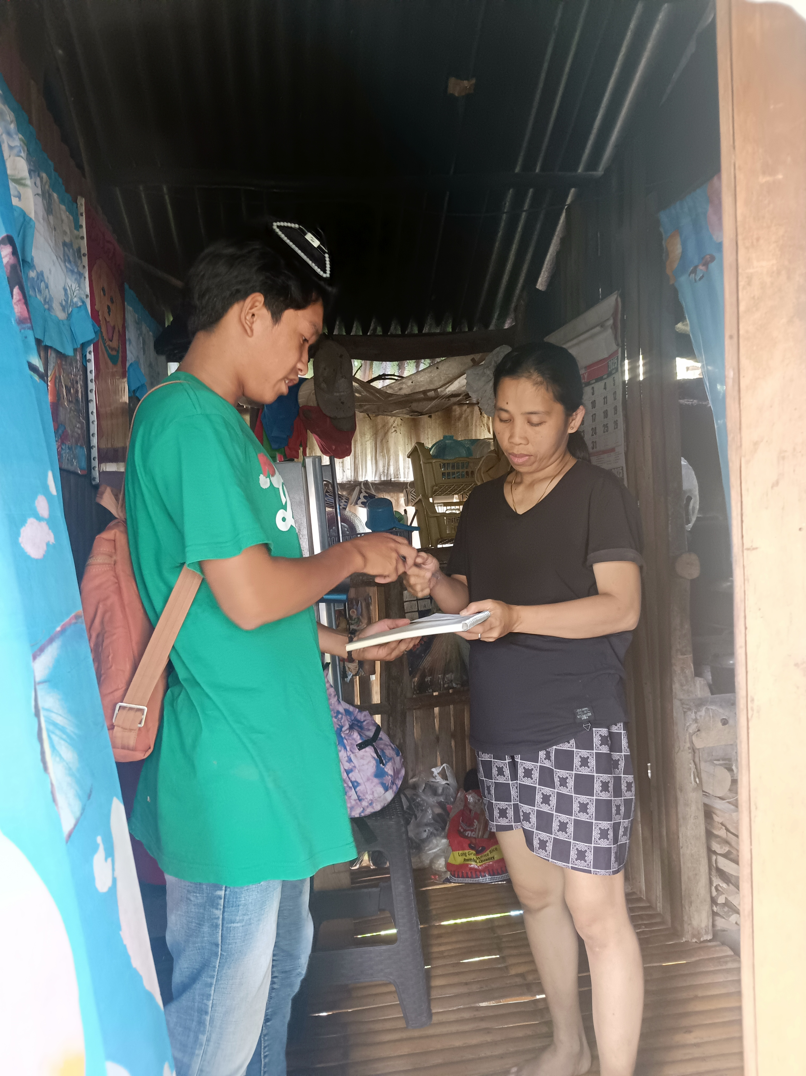
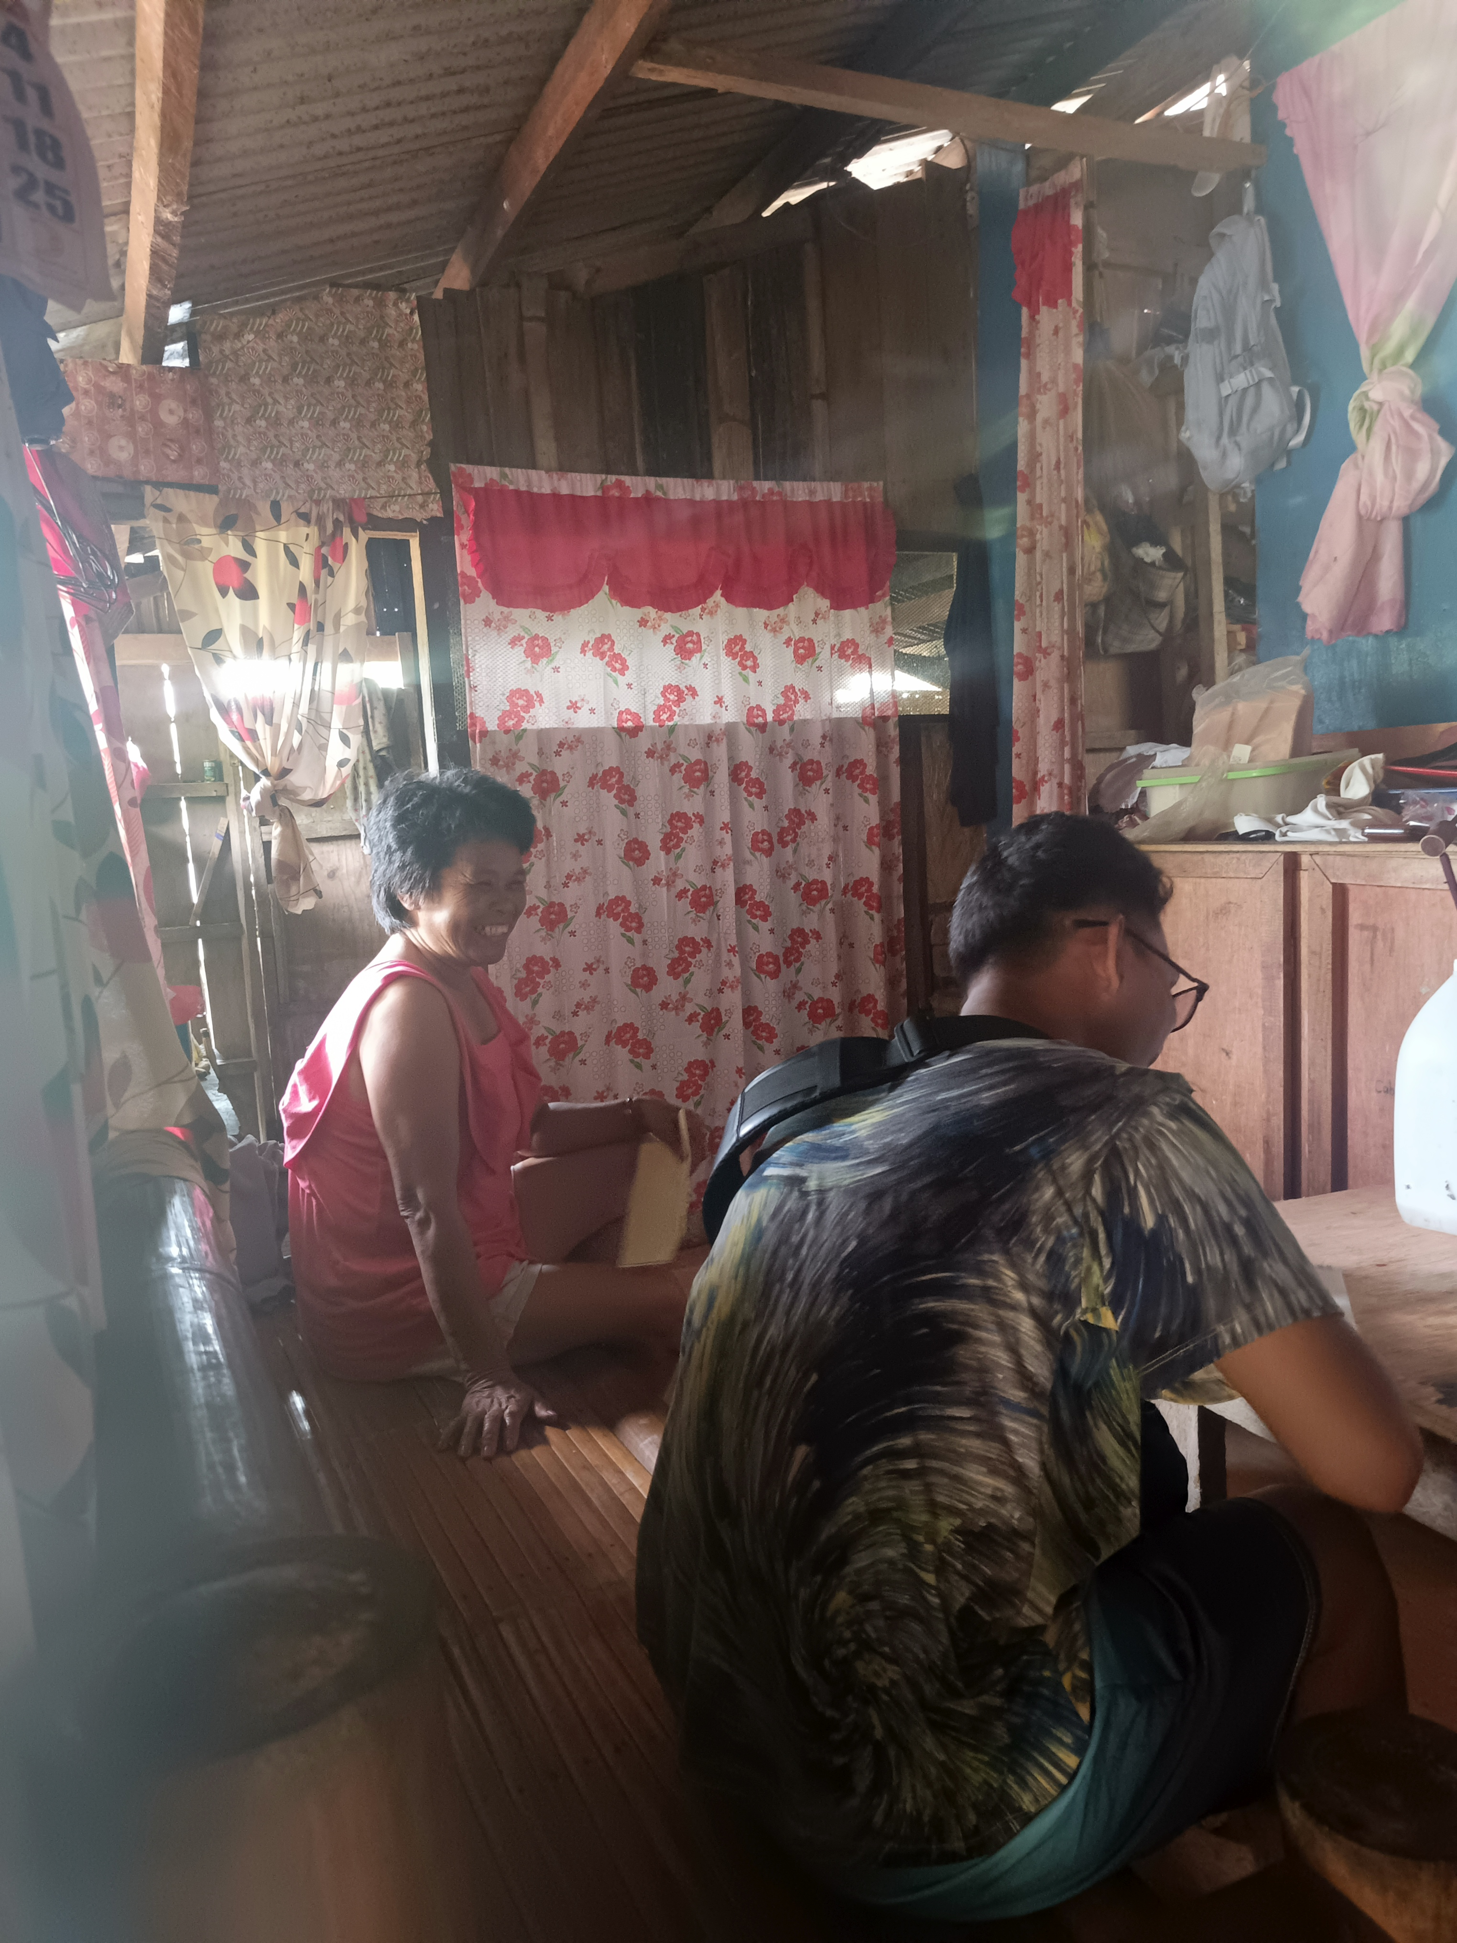
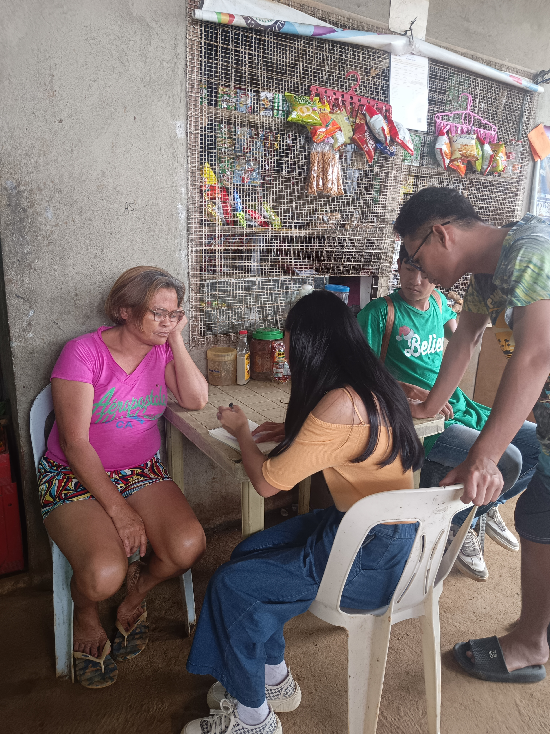
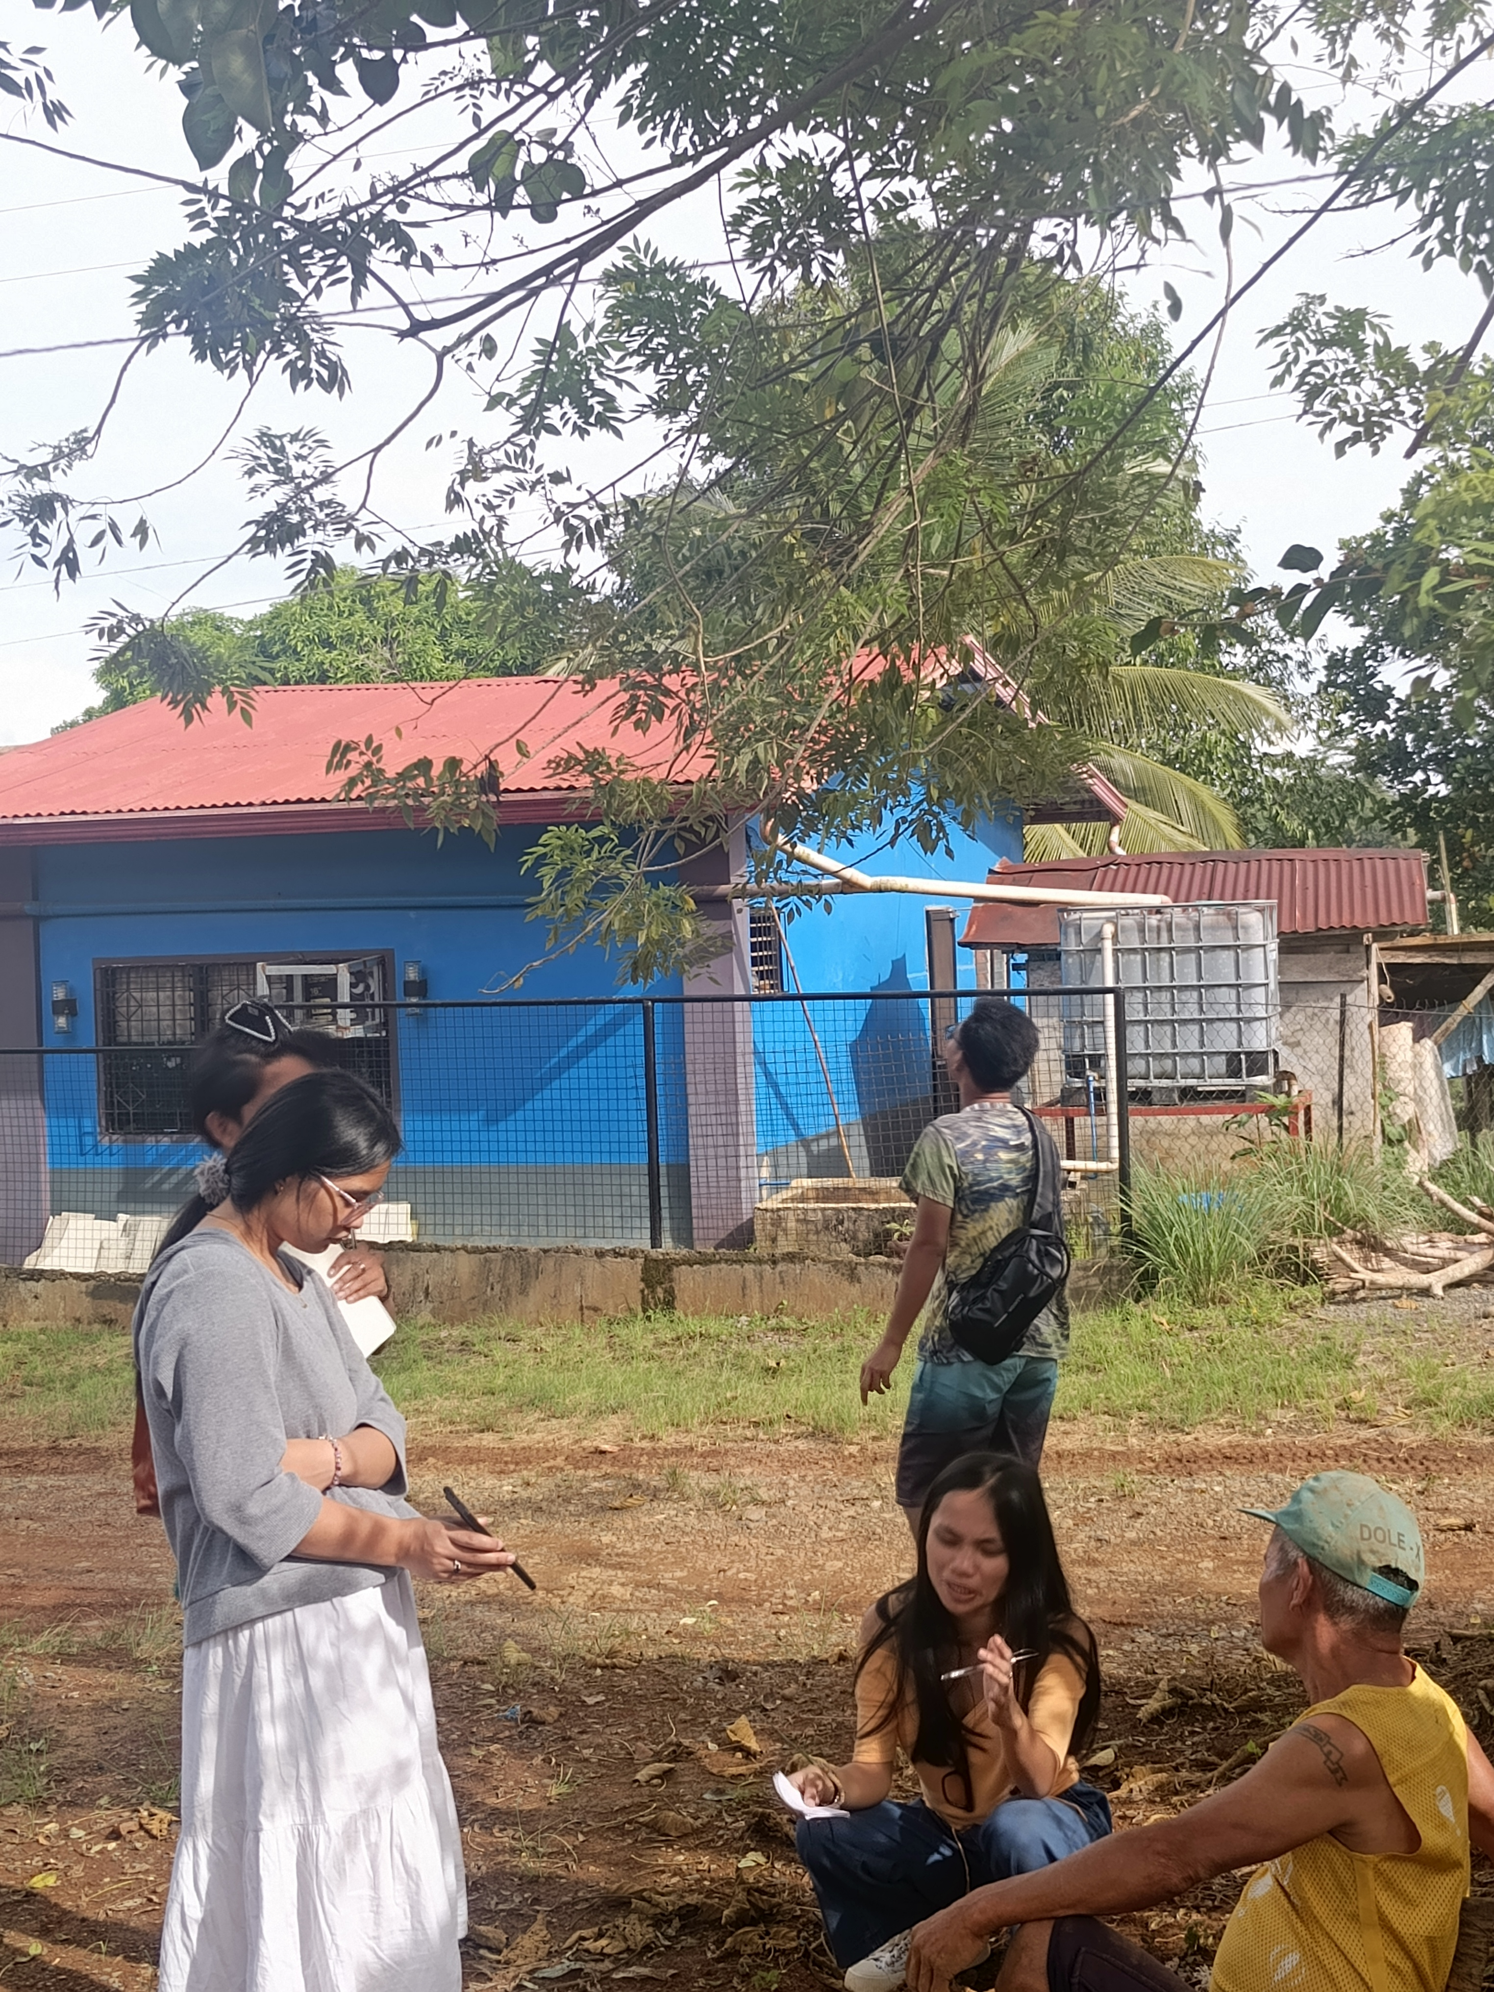
DOCUMENTATION DURING CUSTOMER DISCOVERY

Slide 12
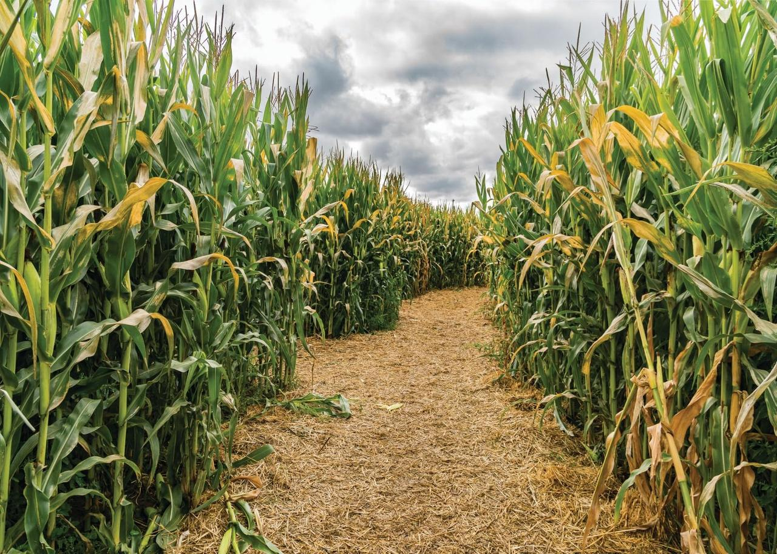
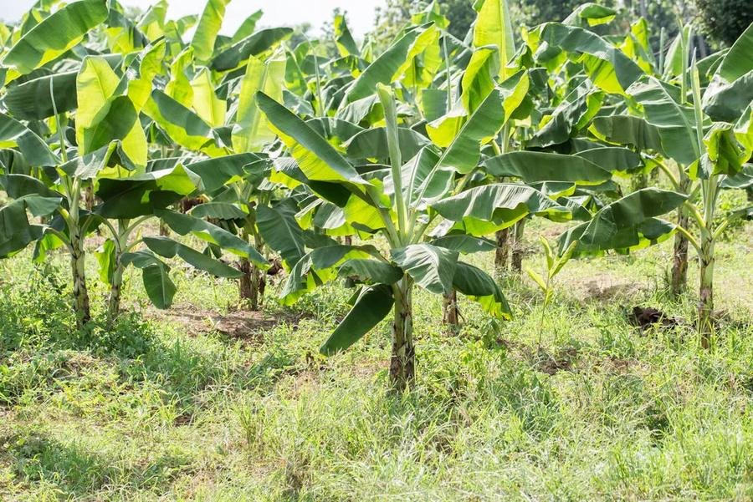
THANK YOU!

